Slide 1

Class 5: Resource Management and Governance with some examples
Larry Swatuk
lswatuk@mta.ca

Slide 2

Poor Management reflects Poor Governance
Notes:
Moai statues on Easter Island

Slide 3
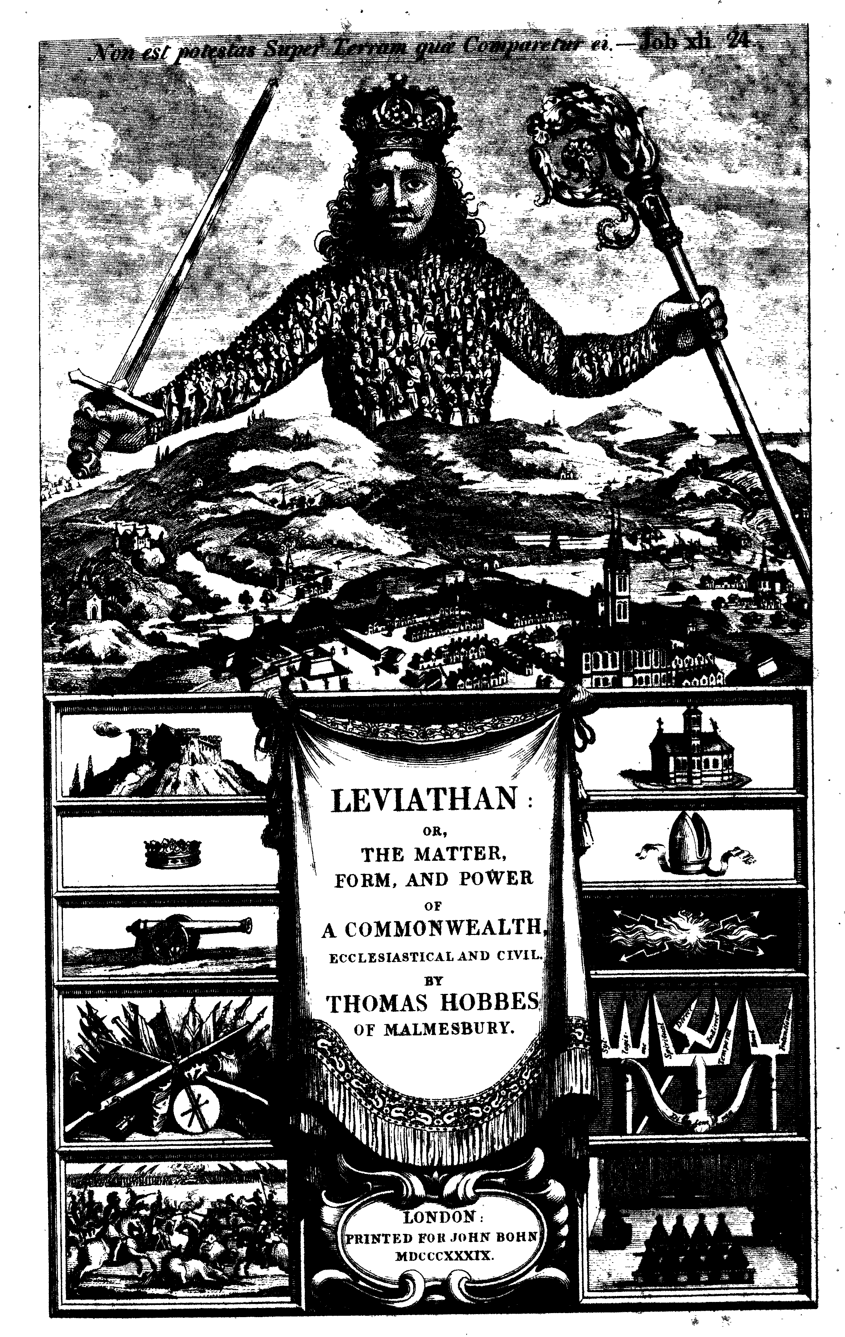
Governance in relation to Management
Governance defines the rules and authority for decision-making, while management implements those decisions and provides feedback that enables governance to adapt over time.
“Governance decides, management delivers”

Slide 4
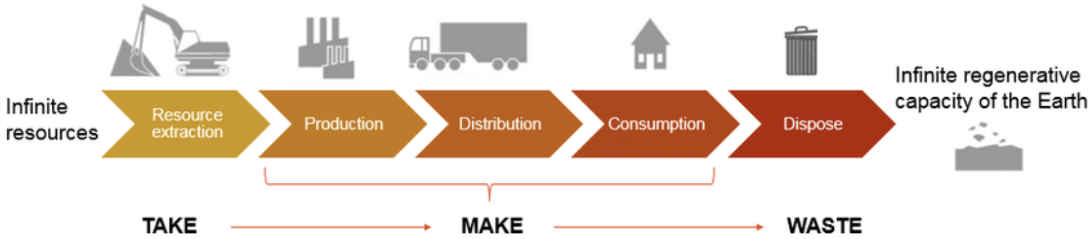
Traditional Resource Management System

Slide 5
Traditional “High Modern” Approach
Reached its apex in the “high-modern industrial” age (Allan’s Paradigm 3)
Humans manage nature
The ‘system’ is linear and predictable (”uncertainty” is minimized or ignored)
The primary focus is to maximize resource yield and efficiency
The knowledge base is technical and expert-driven
Governance is centralized, sectoral
Characterized by top-down decisions with a “command and control” approach

Slide 6
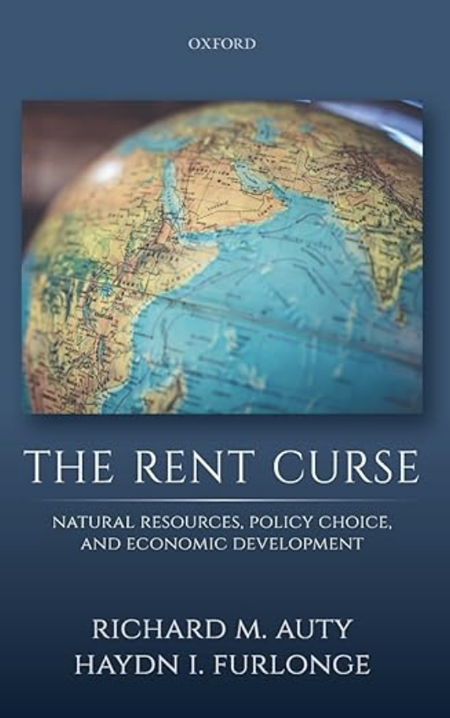
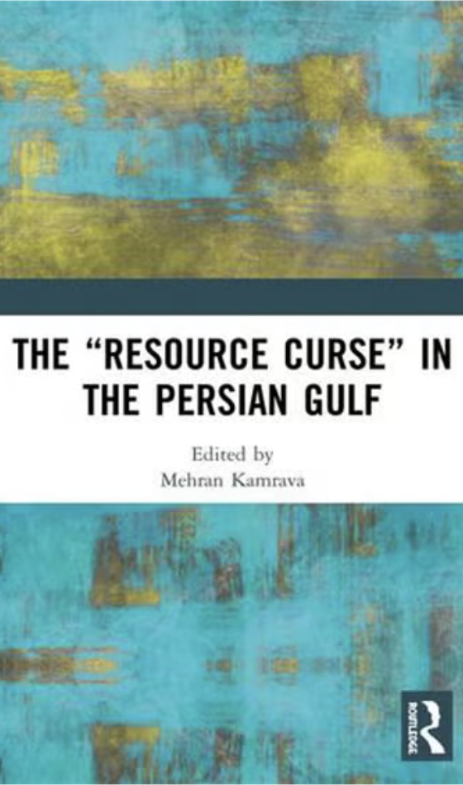
“Bad” Management & “Bad” Governance
Governance is centralized, sectoral
Characterized by top-down decisions
“command and control” approach

Slide 7
Interrelationship of Dominant Actors: aka the ‘social relations of production’
State (.gov)
Civil
Society
(.org)
Private
Sector
(.com)

Slide 8
Constellation of Social Forces: Who has power?
Point of Resource
Extraction
4
-Political and economic power
-Ideational power
-National and International
actors
3
2
1
-Direct beneficiaries
-Marginalized
-Excluded
Point of decision-
making
Idea initially developed by Canadian scholar, Robert Cox

Slide 9
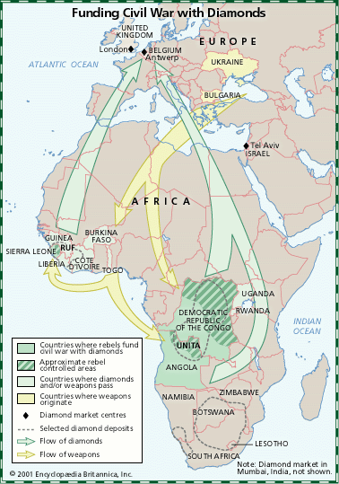
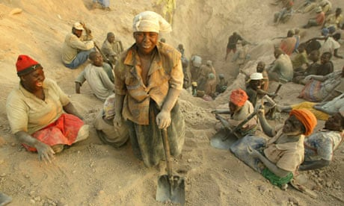

“Blood Diamonds”

Slide 10
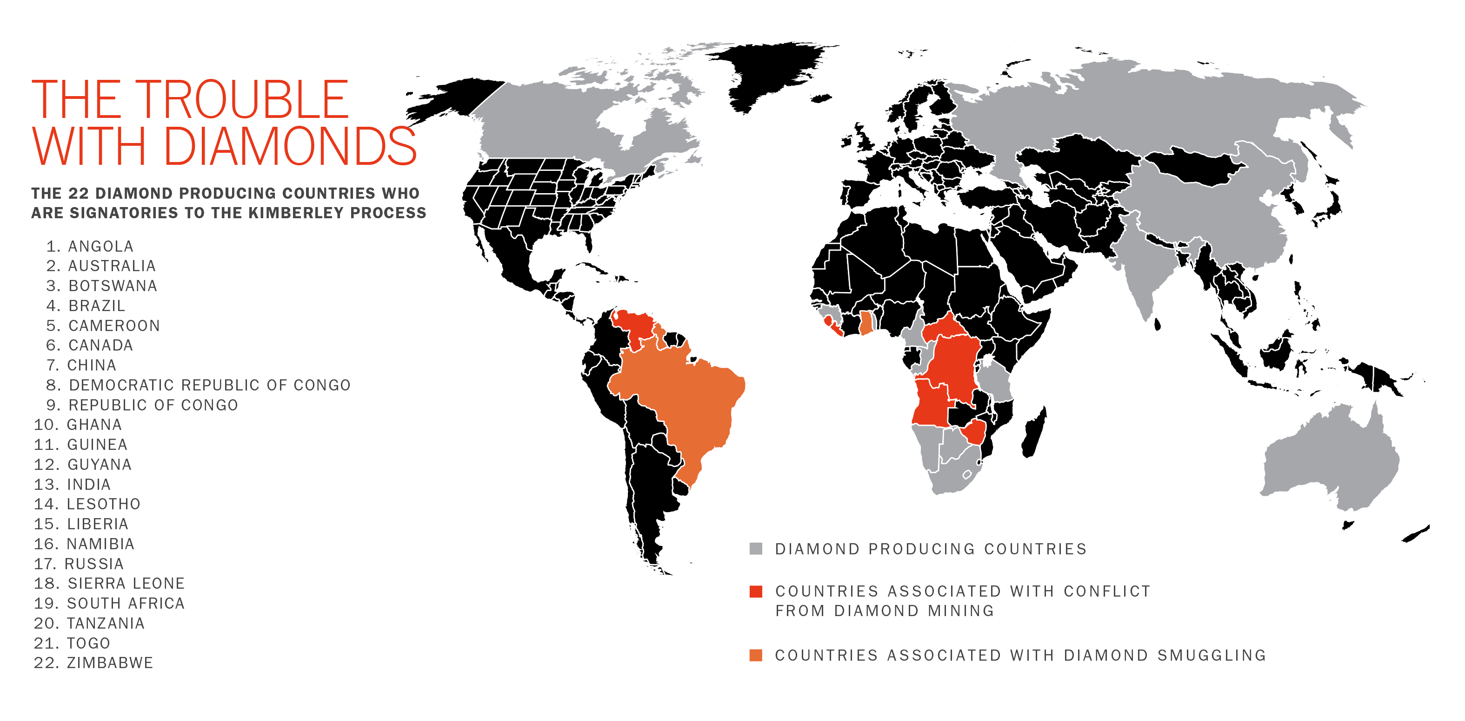
The Kimberley Process

Slide 11


Slide 12
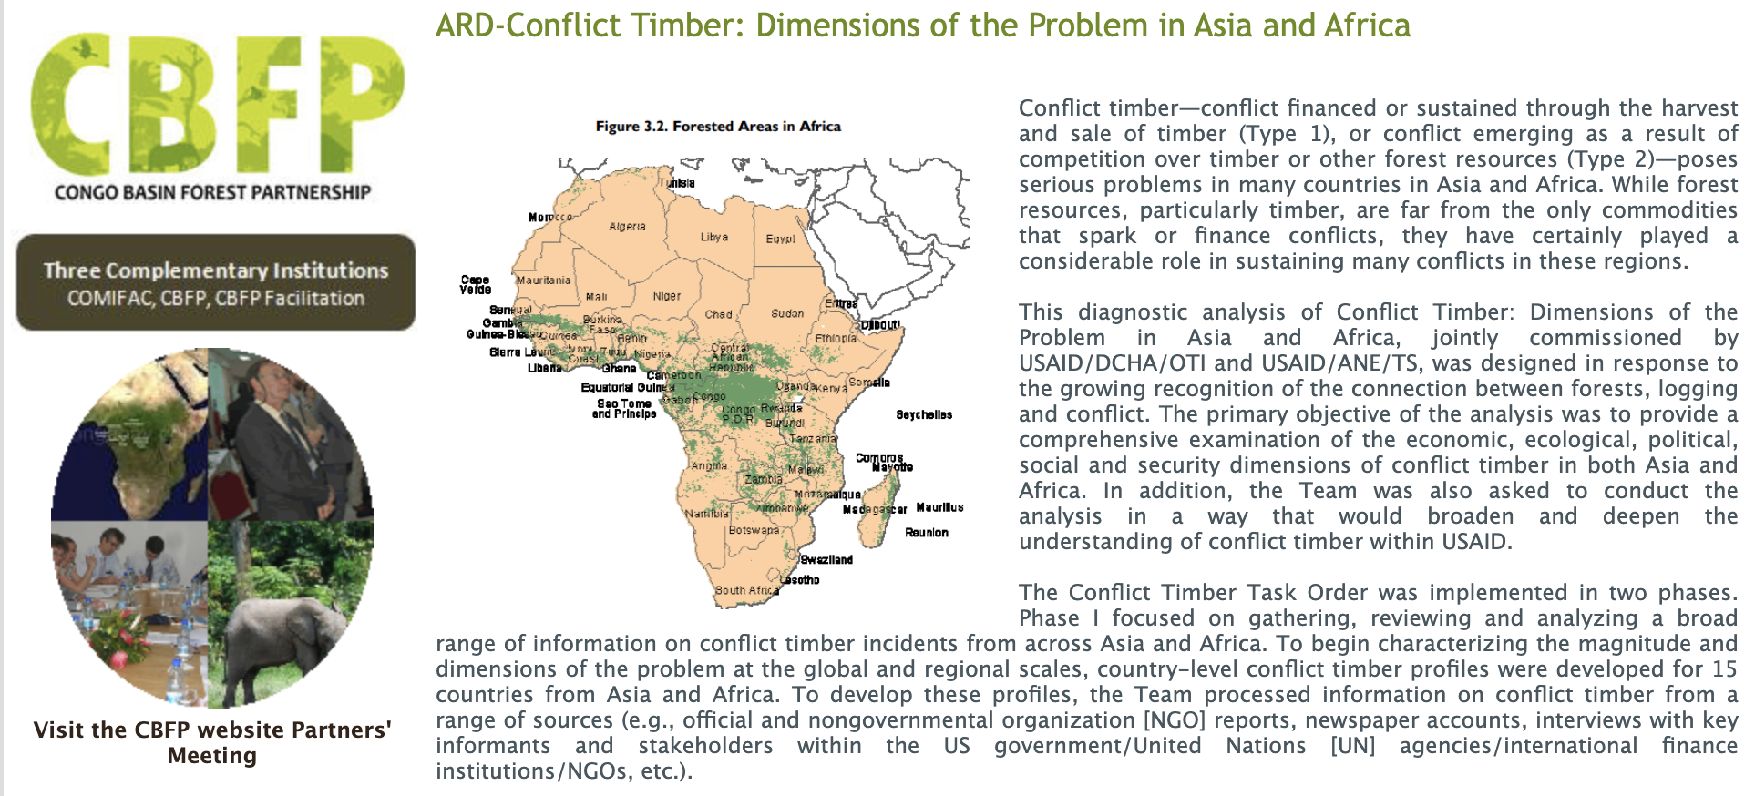

Slide 13

”Blood Timber”
https://www.theguardian.com/global-development/2025/may/06/colombia-blood-timber-trade-western-importers

Slide 14



Post-Cold War, World Bank definition of “Governance”
‘The use of political authority and the exercise of control over society and the management of its resources for social and economic development’ (Serageldin and Landell-Mills,1991).

Slide 15
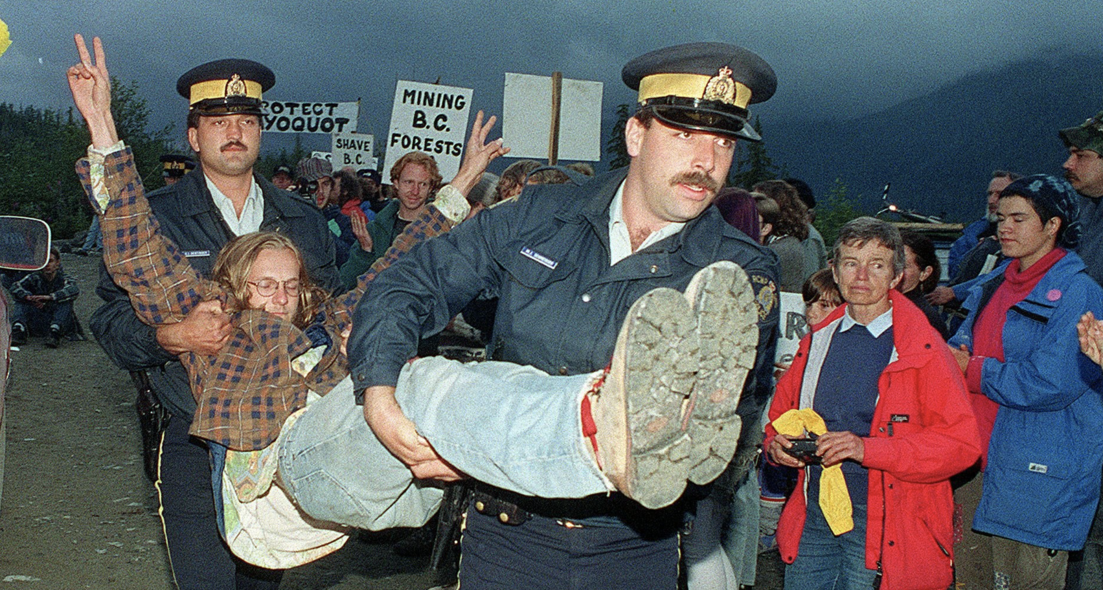
Governance (and Government)
Governance refers to the broad processes, actors, and rules through which collective decisions are made and implemented, whether by the state or not.
Government refers to the formal institutions of the state that exercise authority.

Slide 16
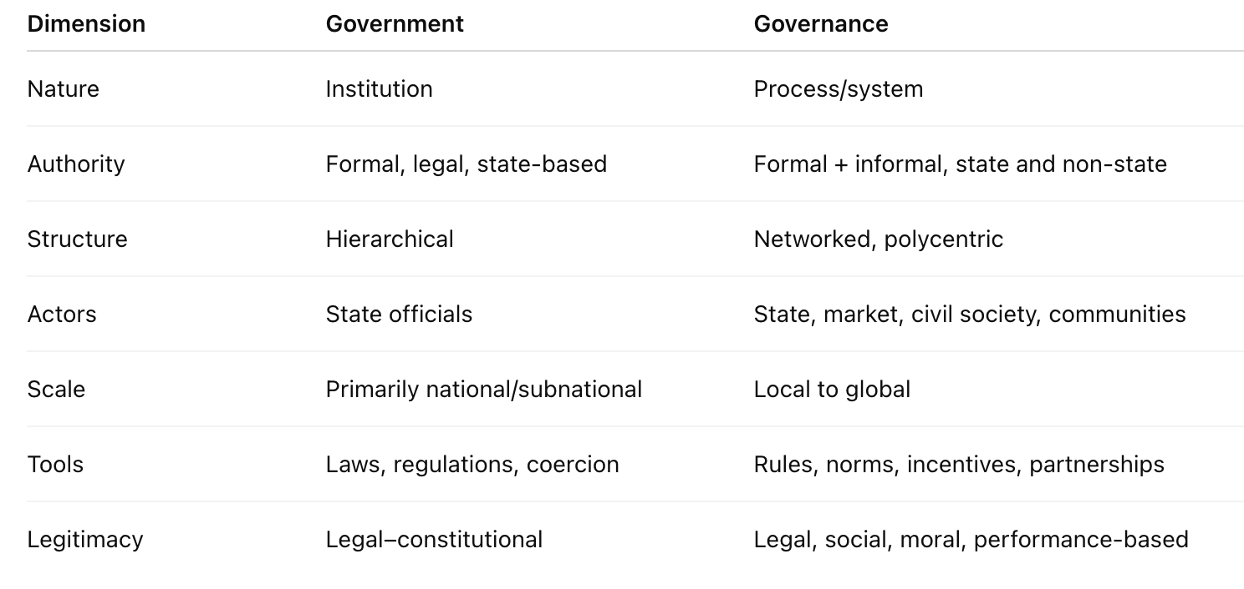

Slide 17
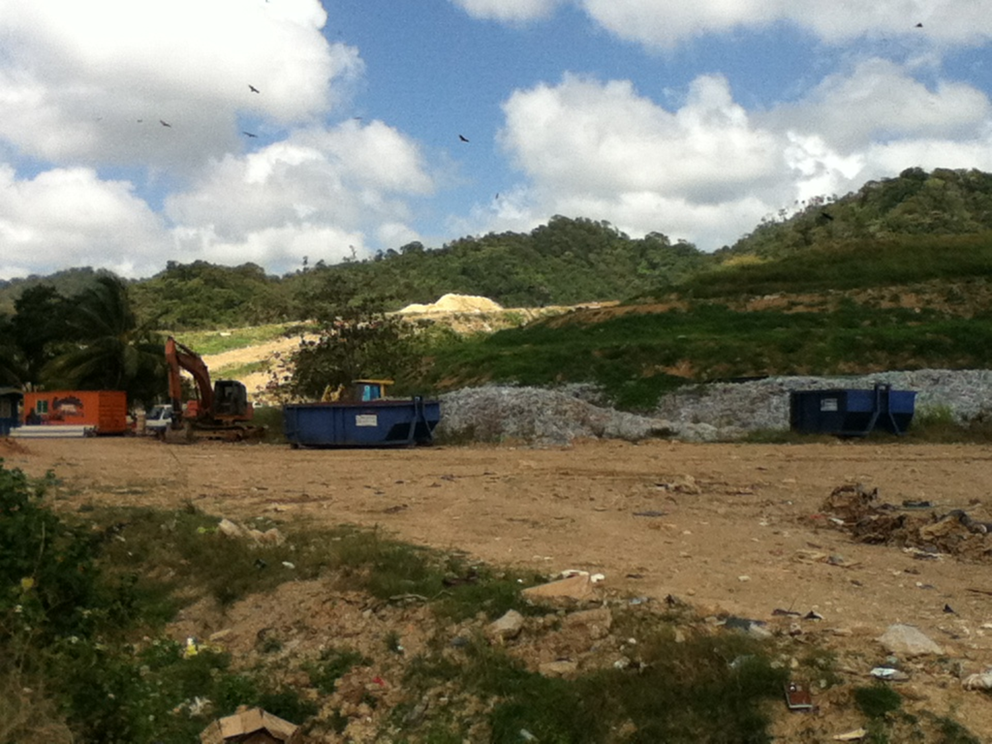
Governance
Governance is both outcome and process, involving a variety of legitimate and authoritative actors.
Good governance can never reach an end point; as a process it depends on the reiteration of activities that deepen trust
Notes:
As an outcome it reflects settled social relations. If it is good, it suggests widespread – if not universal – social approval of its practices. It is most readily constituted and observable at a local level, so raising questions about the fungibility of effective local governance, in particular the ways and means of moving from one socio-geopolitical scale to another.

